Slide 1
Acknowledgment of Paternity Certification Training
Child Support Division  Texas Attorney General
Notes:
Provide trainees with VSS’s AOP User Guide, and direct them to the link on VSS’s TxEVER website:
https://dshs.texas.gov/vs/field/The-TxEVER-Project/#User%20Resources%20and%20Guides

Slide 2
AOP Training - Introduction
Objectives of AOP Certification Training
After completing this course, you should be able to:
Define voluntary paternity establishment and the appropriate use of the Acknowledgment of Paternity (AOP).
Identify legal and relational impacts to families who complete an AOP.
Recognize and respond to common concerns unmarried parents have about establishing paternity.
Properly administer the AOP process in full compliance with state code requirements.
Demonstrate ability to identify situations that are not appropriate for the AOP and identify and explain alternate paternity establishment methods.
Identify best practices for administering AOP services.

Slide 3
Basics of Paternity
What is an Acknowledgment of Paternity (AOP)?
The AOP is a legal document parents can complete to voluntarily establish legal paternity for their child.
Paternity = Legal Fatherhood

Slide 4
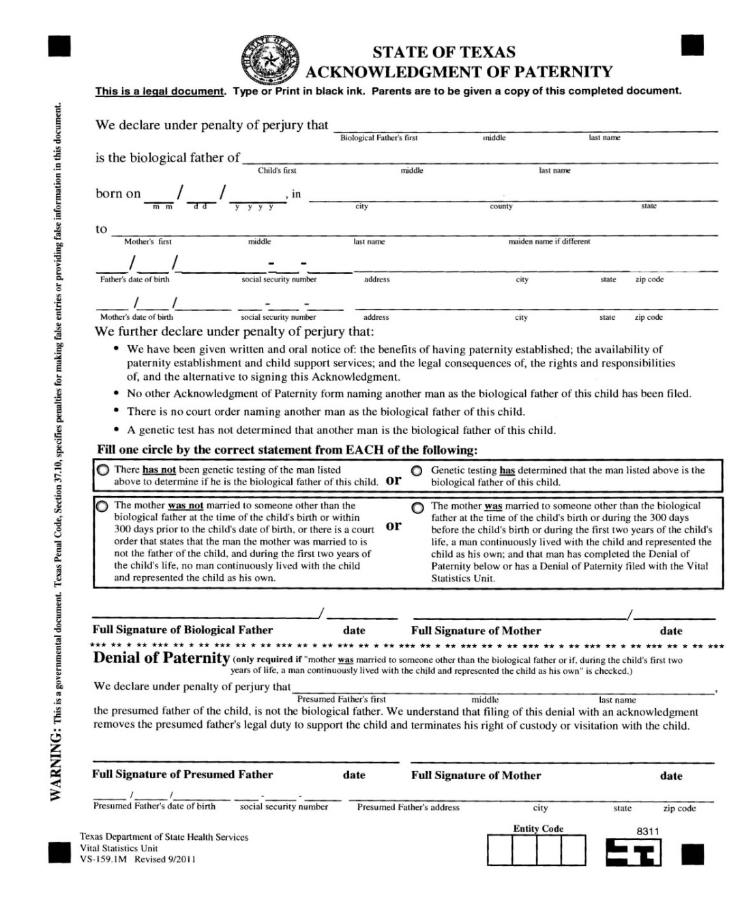
What is the AOP?
Basics of Paternity
The AOP is a way to establish legal paternity for a child whose biological parents were not married to each other when their baby was born.
Once the AOP is filed with the Vital Statistics Section, it becomes a legal finding of paternity.
Document for training
purposes only

Slide 5
What is the AOP?
Basics of Paternity
The AOP is also a way for the presumed father to deny legal paternity.
Denial of paternity can only occur when the mother, biological father and presumed father all agree to use the AOP to establish a legal father for the child.
Document for training
purposes only

Slide 6
Basics of Paternity
What are the benefits of establishing paternity?
A father-child connection is more likely to develop.
Increased emotional support and security for the child.
Provides father and child with legal rights.
Provides the child with a sense of identity and connection to family.
Child may be entitled to ongoing financial support from his or her father.
Access to the father’s medical history.
Eligibility to inherit or access medical, Social Security, or military benefits.
Generally, everyone in the family benefits when paternity is legally established – dad, mom, and most importantly, the child.

Slide 7
Basics of Paternity
When can the AOP be done?
Before the baby is born
When the baby is born (such as in the hospital)
Anytime after the baby is born and before a child support order is established or a paternity determination is made

Slide 8
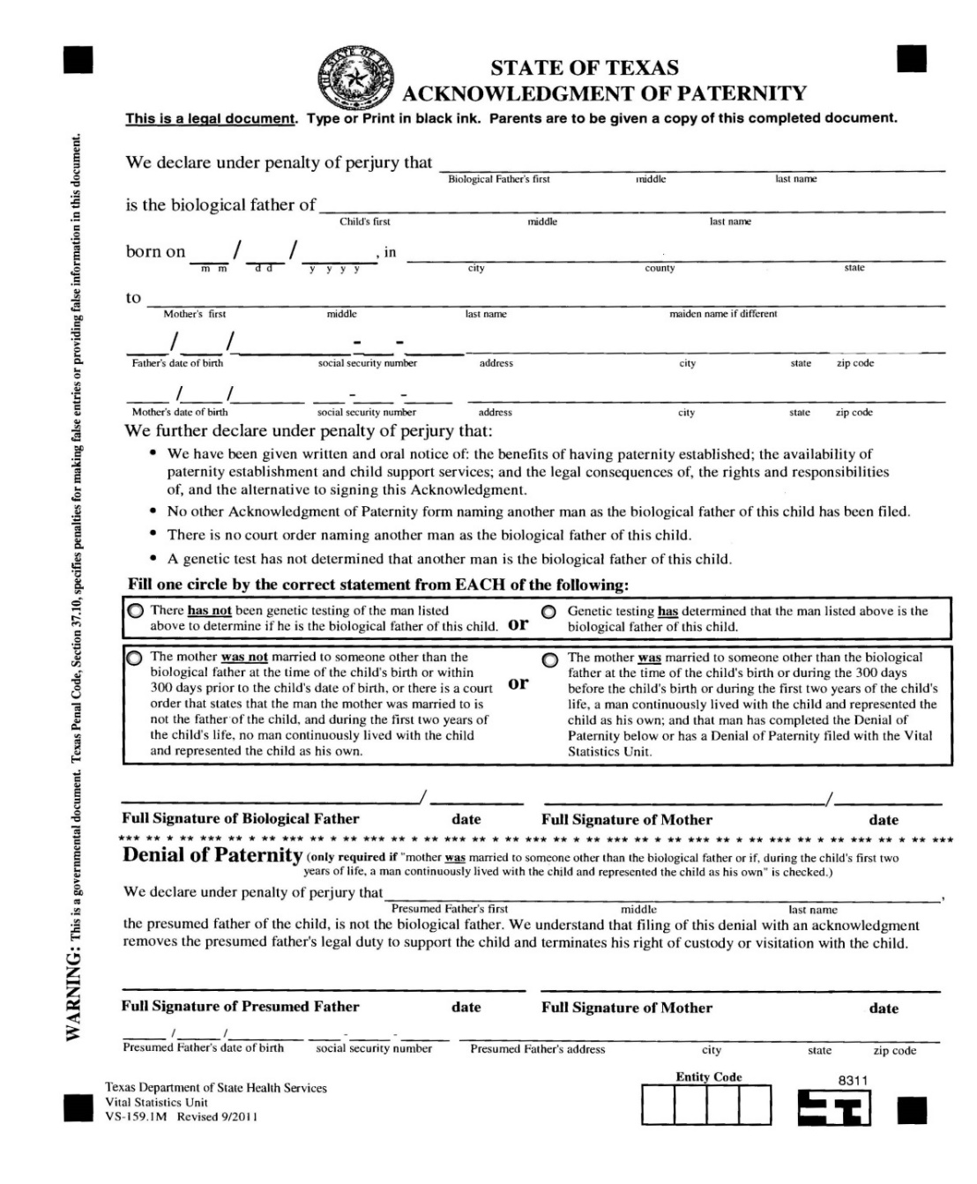
Who signs the AOP?
Basics of Paternity
Always:
Biological mother
Biological father
Sometimes:
Biological mother’s signature in the denial section
Presumed father
The biological father is the man who conceived the child with the mother.
The biological mother is the woman who gave birth to the child.
A presumed father is most commonly the biological mother’s husband or recent former husband.
Document for training
purposes only

Slide 9
Instructions
A certified entity is a person who:
Assists parents with completing AOPs in order to establish paternity.
Has received training from the Office of the Attorney General in the last year.
Has a valid entity code.
Has access to TxEVER, including the AOP TxEVER functions through the Vital Statistics Section.

Slide 10
Instructions
Your Responsibilities as a Certified Entity
Complete AOP Certified Entity Training provided by the Office of the Attorney General (OAG) at least once a year.
Provide parents with all legally required information about paternity establishment and child support services.
Ensure the AOP and Parent Survey are completed correctly.
Provide a copy of the completed AOP form to all signatories.
File the completed AOP form with the Texas Department of State Health Services, Vital Statistics Section using the Texas Electronic Vital Events Registrar (TxEVER) system.
Retain any hardcopy original documents according to your organization’s retention policy, or a minimum of two years.
If necessary, provide instructions and assistance to rescind an AOP.

Slide 11
Instructions
Laws Regarding the AOP
Laws that address the AOP process are listed below.
United States Code Chapter 42, Section 666 (a) (5) (C) (D) and (E)
Texas Family Code Chapter 160, Subchapter D
Texas Health and Safety Code Attachment 1, 192.012
Texas Administrative Code Chapter 55, Subchapter J, Rules 55.401 – 55.409

Slide 12
Instructions
Two-Party AOP
A basic AOP is completed when the following conditions are met:
Biological mother and father are not married.
Parents are certain the man who wants to sign the AOP is the biological father.
Parents are willing to sign the AOP.

Slide 13
Instructions
AOP Guidelines
Only parties to the AOP should be present.
Never give out a blank AOP.
Never leave an AOP with parties who are unattended.
All parties must provide appropriate identification (ID) prior to signing the AOP.
Picture ID is preferred but not required.
Notes:
Original form must be used in those instances when C.E.s will complete an AOP manually due to power outage or internet outage, or other TxEVER technical difficulty that requires usage of an original form. The manually completed AOP must then be submitted (uploaded) to TxEVER.
Certified entities should be reminded that they should never leave a blank AOP with parties.

Slide 14
Instructions
Appropriate Identification
Texas Administrative Code, Chapter 55, Subchapter J, Rule 55.404 and 55.408
All parties must show an ID before signing the AOP. Names on the ID and AOP should match. Note on the Parent Survey what type of identification the parents provided. Make a copy of the ID and staple it to the Parent Survey.

Slide 15
Instructions
Examples of Acceptable IDs:
Driver’s License (valid or expired)
Passport
Work ID
Credit Card/Debit Card
Current Utility/Cell Phone Bill
Student ID
Birth Certificate (including foreign)
Social Security Card
Current Report Card
Mother’s Medical Record (only in hospital)
Mother’s Hospital Bracelet (only in hospital)
Military ID
Offender ID
Firearm License
Voter Registration Card
Any state issued ID or Foreign ID

Slide 16
Instructions
Step-by-Step
Step | Process | Complete?
1 | Determine whether an AOP is appropriate
2 | Provide all required information
3 | Reassess whether an AOP is appropriate
4 | Complete the AOP
5 | Review the completed AOP
6 | Complete a Parent Survey
7 | Submit the AOP to VSS via TxEVER
8 | Provide all required copies to parent(s)
9 | Retain original documents

Slide 17
Instructions
Step 1: Determine whether an AOP is appropriate.
Evaluate if the following statements are true or false:
The parents were unmarried when their child was born and there is no presumed father.
All parties to the AOP are certain that the man who wants to sign the AOP is the biological father.
Both biological parents want to voluntarily establish legal paternity for their child.
All parties to the AOP are capable of understanding the legal consequences of signing the document.
if the answer is TRUE to all, continue the AOP process.
if the answer is FALSE to any, pause the AOP process.

Slide 18
Instructions
Ask the mother:
Are/Were you married to the biological father when the child was born?
Are/Were you married to a man other than the biological father when the child was born?
Have you ever been divorced from a man? If so, when were you divorced (date)?
Has a court order excluded the man you were married to as the father of the child?
Non-newborns:
Has a man lived with the child continuously during the first two years of the child’s life and represented the child as his own?
Does a child support order exist for this child?

Slide 19
Instructions
Step 1: Determine whether an AOP is appropriate.
Next, ask yourself these questions:
Am I related to any of the parties listed on the AOP?
Am I good friends with any of the parties listed on the AOP?
Am I aware of a presumed father who cannot or will not sign the Denial of Paternity portion of the AOP?
Am I aware of an existing child support order for this child?
If the answer is NO to all, continue the AOP process.
If the answer is YES to #1 or #2, find another certified staff member to complete the AOP process.
If the answer is YES to #3 or #4, stop the AOP process and redirect the couple to another paternity establishment option (OAG or private attorney).

Slide 20
Instructions
Step-by-Step
Step | Process | Complete?
1 | Determine whether an AOP is appropriate
2 | Provide all required information
3 | Reassess whether an AOP is appropriate
4 | Complete the AOP
5 | Review the completed AOP
6 | Complete a Parent Survey
7 | Submit the AOP to VSS via TxEVER
8 | Provide all required copies to parent(s)
9 | Retain original documents

Slide 21
Instructions
Step 2: Provide all legally required information
Texas Health and Safety Code 192.012 requires parents be given all of the following:
Written Information
Oral Information
Explanation
Notes:
There is also an Benefits, Rights & Responsibility audio file that can be played.

Slide 22
Instructions
Step 2: Provide all legally required information
Written Information
Provide parents with a copy of the Benefits, Rights and Responsibilities document.
Give parents brochures and handouts about the availability of child support services provided by the Office of the Attorney General.
Oral Information
Read the Benefits, Rights and Responsibilities document line-by-line to the parent, or
Call (866) 255-2006 and allow the parent to listen to the recording in English or Spanish, or
Allow the parent to watch the AOP DVD.
Explanation
After written and oral information is given to the parents, answer the parents’ questions to the best of your ability.
Explain every part of this document until you are sure it is understood.
Notes:
There is also an Benefits, Rights & Responsibility audio file that can be played.

Slide 23
Instructions
Step 2: Provide all legally required information
The next few slides will assist you in explaining the Benefits, Rights and Responsibilities document to the parents.
Explaining the Benefits, Rights and Responsibilities of the AOP is the most important part of the AOP process.
Notes:
The reason the BRR is the most important part is that parties to the AOP should understand the legal consequences of voluntarily establishing the legal rights of a biological father.

Slide 24
Instructions
A genetic test is also called a DNA test.
If you even think you might want a DNA test, DO NOT sign the AOP.
A DNA test can be done in a private lab or by opening a case with the OAG. The first test is free if you open a case with the OAG.
Only DNA tests done through a lab accredited by the American Association of Blood Banks will be considered in court. Tests done in non-accredited labs and over-the-counter “home testing kits” will not be considered as evidence in court.
The OAG will not order a DNA test if the parents have already signed the AOP.
This is important! The AOP is only used when all parties agree. There are other ways to establish paternity when the parties are not in agreement.
The biological father is the man who conceived the child with the mother.
This document carries the same weight as a court order establishing paternity.
Notes:
Just like TER, TxEVER will not print out the BRR with the AOP. Certified entities must photocopy the BRR to the back of the AOP. This is not a change in process. Simply a reminder that the BRR must be made available to the parents along with the AOP.

Slide 25
Instructions
In Texas, both legal parents are responsible for the financial and emotional support of their child.
Some rights you may have as a legal parent include:
Access to your child’s medical and school records
The right to request custody, visitation or financial and medical support for your child
Your name placed on the birth certificate
Your benefits (such as Social Security or military) may go to your legal child

Slide 26
Instructions
Only the legal father’s name may be placed on the birth certificate. If the AOP is completed at the time of the child’s birth, the father’s name is automatically listed. If the AOP is completed at a later time, you must amend, or change, the child’s birth certificate.
To change the child’s birth certificate based on an AOP, both parents must sign (before a notary public) the Correcting a Birth Certificate VS-170 form from Texas Vital Statistics. (More detail will be provided about this form later in the training.)
Notes:
VS 170 – Correcting a Birth Certificate application
https://dshs.texas.gov/vs/reqproc/forms/Amendment_Birth_Form_Final.pdf
All VSS forms - https://www.dshs.texas.gov/vs/reqproc/Vital-Statistics-Forms/

Slide 27
Instructions
Indications that a man is a presumed father:
He was married to the biological mother at the time of the child’s birth, or
He was married to the biological mother within 300 days before the child’s birth, or
He continuously lived with the child for the first two years of the child’s life and represented the child as his own.
NOTE: The Denial of Paternity is unnecessary if a divorce decree specifically states the husband is not the biological father of the child.
This is very important! The AOP is used only for biological parents to establish paternity. If the presumed father is the biological father, and he wishes to relinquish his parental rights, the AOP is not the correct process.
Certified entities must read this section unless they are absolutely certain there is no presumed father. BEST PRACTICE: Review it with all parents.
Notes:
It is critical for certified entities to ensure that moms who chose to sign the AOP understand that if there is a Presumed Father, the Presumed Father must sign the denial portion of the AOP in TxEVER with the help of a certified entity.
Emphasize that it is important to get the AOP done right the first time, otherwise the AOP could be “legally void” (no good) if the court ever gets involved in the future (e.g. future divorce proceeding, or setting child support).
BEST PRACTICE: Read this section to all parties, even if the mother claims that there is no presumed father. It gives her a chance to listen to this important information, and allows you to be certain that you did your due diligence with the parents.

Slide 28
Instructions
Cover this section very carefully with the parent.
Rescission –If any party changes his or her mind about signing the AOP, he or she can file the “Rescission of Acknowledgment of Paternity” (VS-158) to invalidate the AOP before the earlier of:
The 60th day after the AOP was originally filed with VSS; or
A legal proceeding has been initiated regarding the child
To Challenge the AOP :
If any party to the AOP changes his or her mind after the timeframe for rescission has elapsed, that person may challenge the AOP by filing a lawsuit with the court and going before a judge to prove fraud, duress or material mistake of fact.
A challenge to the AOP can be filed any time before the issuance of an order affecting the child, including a child support order.
Challenging an AOP may require the assistance of a private attorney.
The OAG does not assist parents with challenging the AOP.

Slide 29
Instructions
Certified entities can protect against challenges by:
Never administering the AOP with relatives or anyone you know well.
Only administer the AOP when you are certain that the parent does not feel pressured by anyone who may be present when the AOP is being discussed or signed.
Ensuring the party, you are assisting understands all the information presented to him or her.
Giving the parties accurate information about DNA testing.
Mistake of fact - an error discovered to be incorrect at a later time
For example, a DNA test result that excludes the legal father as the biological father may be considered a material mistake of fact.
Fraud - the intentional use of deceit or some dishonest means
Duress - the use of force or threats to compel someone to act contrary to his or her wishes or interests

Slide 30
Instructions
If no party to the AOP is a minor, the certified entity does not have to read this section aloud.

Slide 31
Instructions
Step 2: AOP DVD

Slide 32
Instructions
Step-by-Step
Step | Process | Complete?
1 | Determine whether an AOP is appropriate
2 | Provide all required information
3 | Reassess whether an AOP is appropriate
4 | Complete the AOP
5 | Review the completed AOP
6 | Complete a Parent Survey
7 | Submit the AOP to VSS via TxEVER
8 | Provide all required copies to parent(s)
9 | Retain original documents

Slide 33
Instructions
Step 3: Reassess whether an AOP is appropriate
Ask the parents:
Do you have any additional questions about any part of the AOP?
If the answer is YES, answer all questions or refer the parent to the AOP Hotline at (866) 255-2006.
If the answer is NO, continue to the next question.

Slide 34
Instructions
Step 3: Reassess whether an AOP is appropriate
Ask the parents:
Do you understand all that I have read and explained to you about paternity establishment and this AOP form?
Do you want to complete the AOP process, legally establishing paternity for this child?
If the answer is YES to both #2 & #3, continue the AOP process.
If the answer is NO to #2, answer questions to the parent's satisfaction and continue the AOP process or direct the parent to the AOP Hotline at (866) 255-2006.
If the answer is NO to #3, stop the AOP process and refer the parties to the OAG or a private attorney.

Slide 35
Instructions
Step 3: Reassess whether an AOP is appropriate
Ask yourself:
Have I provided all of the legally required information about the rights and responsibilities of paternity establishment and about child support services?
Am I confident this person understands all that I have read and explained about this document?
If the answer is YES to both, continue the AOP process.
If the answer is NO to either, pause the AOP process.
Notes:
Add a question:
3. Am I sure that neither parent feels like they are under duress and that both parents want to voluntarily sign the AOP?

Slide 36
Instructions
Step-by-Step
Step | Process | Complete?
1 | Determine whether an AOP is appropriate
2 | Provide all required information
3 | Reassess whether an AOP is appropriate
4 | Complete the AOP
5 | Review the completed AOP
6 | Complete a Parent Survey
7 | Submit the AOP to VSS via TxEVER
8 | Provide all required copies to parent(s)
9 | Retain original documents

Slide 37
Instructions
Step 4: Complete the AOP
Certified entities must complete AOPs using VSS’ TxEVER system.
Pre/Post Birth AOP Registration
Birth Registration Process
AOPs completed manually must then be upload as a TIFF (no PDFs) to TxEVER.
Please refer to the Department of State Health Services (DSHS) Vital Statistics Section’s TxEVER guide and resources website for detailed instructions on how to electronically submit an AOP.
Notes:
Certified entities can obtain signatures from parents electronically (signature pad, mouse pad, touch screen) or by uploading a signed AOP.
An original AOP form must be used when obtaining wet signatures from parties to the AOP. The AOP must then be scanned and the image must be saved as a TIFF (TxEVER will not accept PDFs or any other file format ---only TIFFs). The TIFF will then be uploaded and saved to TxEVER.

Slide 38
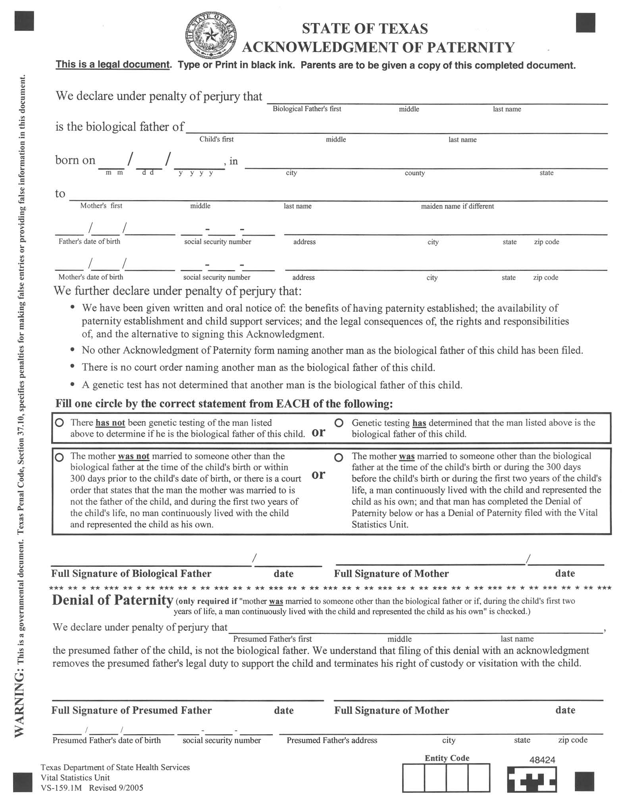
Instructions
Step 4: Complete the AOP
The certified entity completes the first six lines of the AOP and the Denial of Paternity, if applicable.
If you are completing a manual AOP, you must:
Use an original AOP.
Use black ink.
Danny Ray Zuko
Betty Rizzo Zuko
07 15 2015 Rydell Frenchy TX
Sandra Maria Olsen Olsen
12 06 1996 123 23 1234 58 Grease Lighting Rydell TX 76904
05 11 1995 231 31 1321 58 Grease Lighting Rydell TX 76904

Slide 39
Instructions
Step 4: Complete the AOP
Variations on the AOP
Any party who signs the AOP or Denial can request a certified copy of the document and will have access to the other parties’ information.
All parties signing the AOP or Denial need to know they have the right to withhold their Social Security number and address from being printed on the AOP for any reason especially if they indicate safety concerns such as family violence.
Remember: Mark the “Withheld by Request” box to hide the SSN and address on the printed AOP. The information will remain in TxEVER, but “withheld by request” will be printed on the AOP.
Note: If parties do not have a Social Security Number leave that data field blank in TxEVER. If parties do not have an address, type “Withheld” in that data field in TxEVER.
Notes:
Make sure there is something in the address field. Example: Type in “Withheld” and then move on to the next data field by tabbing to the next data field.

Slide 40
Instructions
Step 4: Complete the AOP
Variations on the AOP
Minor parents may complete the AOP without parental consent.
Minor parents also have the same rights to the process for rescission and challenge of the AOP as parents 18 or older.
Notes:
There are no legal requirements for “Common Law Married” to be printed on the AOP. Common law married parents can complete an AOP if they wish, but they are not required to do so.

Slide 41
Instructions
Step 4: Complete the AOP
Texas Penal Code 37.10 TAMPERING WITH GOVERNMENTAL RECORD states that a person commits an offense if he makes, presents, or uses any record, document, or thing with knowledge of its falsity. An offense under this section is a Class A misdemeanor unless the person's intent is to defraud or harm another, in which event the offense is a state jail felony.
Print the AOP and read the document aloud to the parent as you review each section.
Explain “penalty of perjury.”
Danny Ray Zuko
Betty Rizzo Zuko
07 15 2015 Rydell Frenchy TX
Sandra Maria Olsen Olsen
12 06 1996 123 23 1234 58 Grease Lighting Rydell TX 76904
05 11 1995 231 31 1321 58 Grease Lighting Rydell TX 76904
Document for training purposes only
3 3 3 3

Slide 42
Instructions
Step 4: Complete the AOP
If you need to correct an error on a manual AOP or a wet signature AOP:
Do not use correction fluid.
Use one straight line only.
Initial the correction.
Identify initials in the left margin.
Danny Ray Zuko
Betty Rizzo Zuko
JLO
McGee
07 15 2019 Rydell Frenchy TX
Sandra Maria Olsen Olsen
JLO Jennifer Lopez Ortiz – Birth Registrar
12 06 1996 123 23 1234 58 Grease Lighting Rydell TX 76904
05 11 1995 231 31 1321 58 Grease Lighting Rydell TX 76904

Slide 43
Instructions
Step 4: Complete the AOP
Read these statements to the parents.
Have parents confirm each statement circle is filled in correctly.
JLO Jennifer Lo

Slide 44
Instructions
Step 4: Complete the AOP
ID Requirements
Now that the parents are ready to sign AOP, remember:
Search TxEVER for any pre-birth AOPs or partials
All parties to the AOP must provide one form of ID prior to signing.
Picture ID is preferred, but not required.
Names on ID and AOP should match.
Document the type of ID on the Parent Survey.
Notes:
External entities = “Search for AOP”
OAG entities = “Search for a Partial AOP Match”

Slide 45
Instructions
Step 4: Complete the AOP
Signatures
Parents may sign:
First Name, Last Name
First Name, Middle Name, Last Name
First Name, Middle Initial, Last Name
If a parent is unable to sign his or her name, he or she can make any mark, including an “x” or initials.

Slide 46
Instructions
Step 4: Complete the AOP
Dates
TxEVER will automatically populate the signature date when the signature captured and saved to TxEVER.
If wet signatures are obtained the signature dates must be in month day year (mm/dd/yyyy) format.
Entity Code
If the entity code is blank or has an “N”, please write your entity code in the entity code boxes.

Slide 47
Instructions
Step-by-Step
Step | Process | Complete?
1 | Determine whether an AOP is appropriate
2 | Provide all required information
3 | Reassess whether an AOP is appropriate
4 | Complete the AOP
5 | Review the completed AOP
6 | Complete a Parent Survey
7 | Submit the AOP to VSS via TxEVER
8 | Provide all required copies to parent(s)
9 | Retain original documents

Slide 48
Instructions
Step 5: Review the completed AOP
Required Elements
Biological father’s information: full name and date of birth
Child’s information: full name, date of birth, city, county, and state of birth
Mother’s information: full name, including maiden name and date of birth
Appropriate circles filled in the statement boxes
Correct signatures and dates
Your entity code
Notes:
Make sure your entity code is on the AOP before you scan and upload it into TxEVER.

Slide 49
Instructions
Step-by-Step
Step | Process | Complete?
1 | Determine whether an AOP is appropriate
2 | Provide all required information
3 | Reassess whether an AOP is appropriate
4 | Complete the AOP
5 | Review the completed AOP
6 | Complete a Parent Survey
7 | Submit the AOP to VSS via TxEVER
8 | Provide all required copies to parent(s)
9 | Retain original documents

Slide 50
Instructions
Step 6: Complete a Parent Survey
Parent Survey on the AOP
This is required by Texas Administrative Code 55.408.
This survey is proof that you met the requirements of the law, and it may be used as evidence in court.
Obtain copies from the OAG child support website.
The certified entity can explain the parent survey instructions but is not permitted to influence or directly guide the parent in completing the survey.
Retain this survey with a copy of the AOP for a minimum of 2 years.
Notes:
The Parent Survey will continue to be a manual process. You cannot upload the Parent Survey into TxEVER. You must keep the survey on file in accordance to their organization’s record retention policy, but for a minimum of 2 years.
If you obtained electronic signatures on the AOP, print a copy of the AOP for each party and a copy for your records.
If you uploaded a TIFF of the wet signatures, keep the wet signature copy of the AOP. The copy is considered transitory because once it is uploaded to VSS, then VSS becomes the owner of the AOP document.

Slide 51
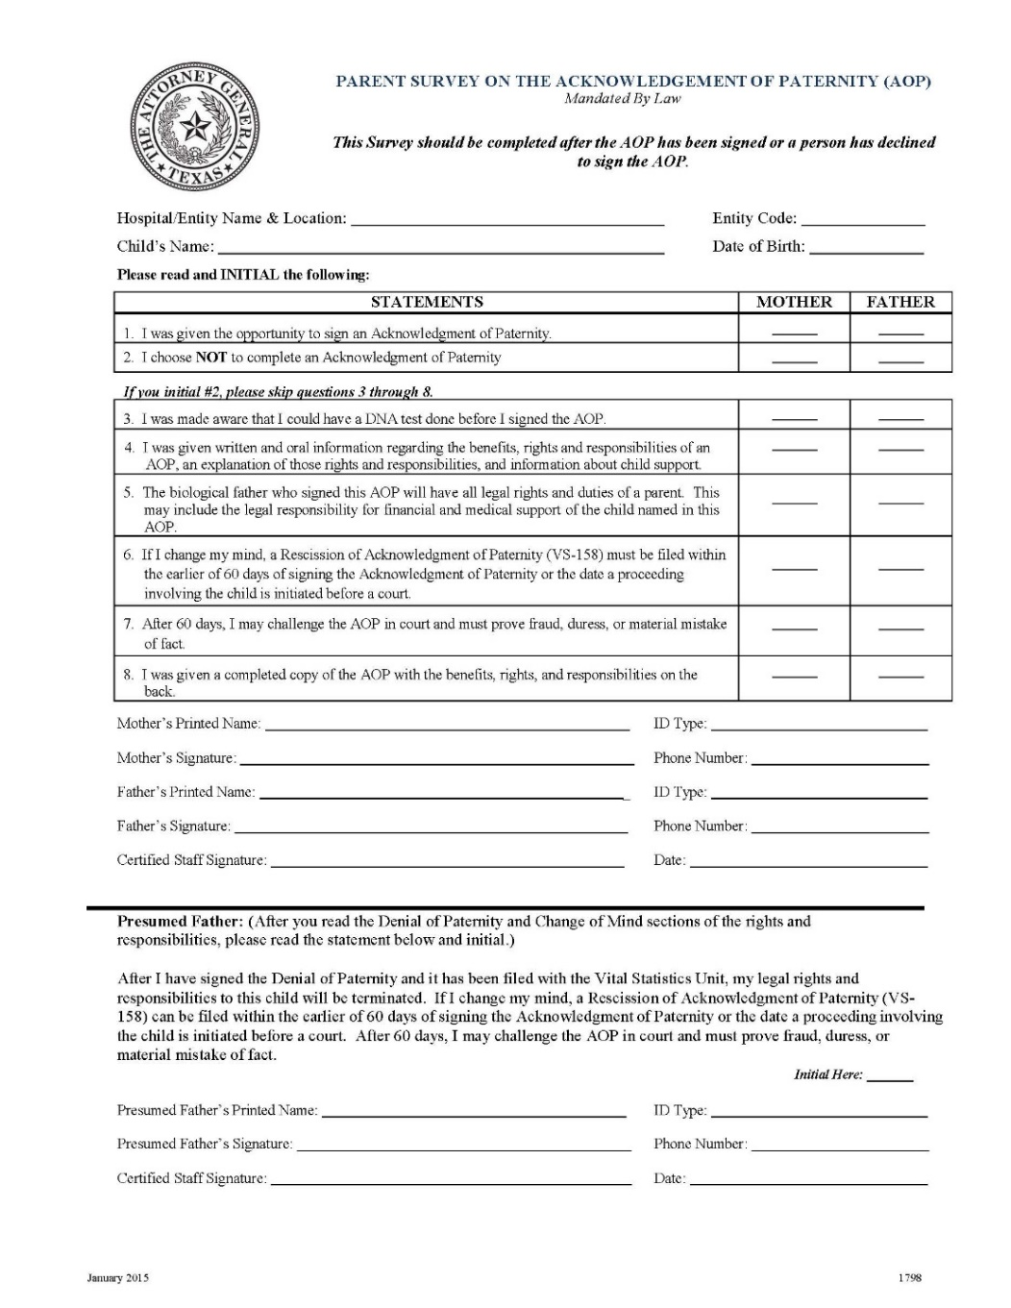
Instructions
Step 6: Complete a Parent Survey
Certified entity does the following:
Completes the top two lines of the form.
Indicates what form of ID was used to complete the AOP.
Copies the ID and staples it to this form (if possible).
Makes sure any sensitive information such as credit card numbers is blacked out.
Rydell Medical Center
3333
Betty Rizzo Zuko
07/15/19
High School Student ID
Report Card

Slide 52
Instructions
Step 6: Complete a Parent Survey
Parents will do the following:
Read and initial every applicable statement.
Print and sign the Parent Survey.
Provide a phone number.
The certified entity will sign and date the completed Parent Survey.
If applicable, have presumed father read, initial, print and sign his name and provide a phone number. The certified entity will record the ID type, sign and date.
Rydell Medical Center
3333
Betty Rizzo Zuko
07/15/19
SO
DRZ
SO
DRZ
SO
DRZ
SO
DRZ
SO
DRZ
SO
DRZ
SO
DRZ
Sandy Olsen
High School Student ID
Sandy Olsen
512-555-1234
Danny Zuko
Report Card
Danny Zuko
512-555-1234
Jennifer Lopez Ortiz
7/16/19

Slide 53
Instructions
Step 6: Complete a Parent Survey
Parent Survey Refusal
Parents who refuse to complete or sign the Parent Survey may still complete an AOP. The certified entity:
Completes the top two lines of the Parent Survey.
Records form of ID presented.
Signs and dates the Parent Survey.
Notes on the Parent Survey that it was offered but refused by the parent (state the reason for refusal, if one is given).
Retains the unsigned Parent Survey with the completed AOP for a minimum of 2 years.
Rydell Medical Center
3333
Betty Rizzo Zuko
07/15/19
High School Student ID
Report Card
Jennifer Lopez Ortiz
7/16/19
Parents refused to complete. Didn’t have time.

Slide 54
Instructions
Step 6: Complete a Parent Survey
Mother Declines AOP
If the mother declines the AOP at the time of birth, a Parent Survey is still required.
The certified entity completes the top two lines.
The mother initials #1 and #2, prints and signs her name.
The certified entity signs and dates the completed Parent Survey.
Rydell Medical Center
3333
Betty Rizzo Zuko
07/15/19
SO
SO
Sandy Olsen
Sandy Olsen
Jennifer Lopez Ortiz
7/16/19

Slide 55
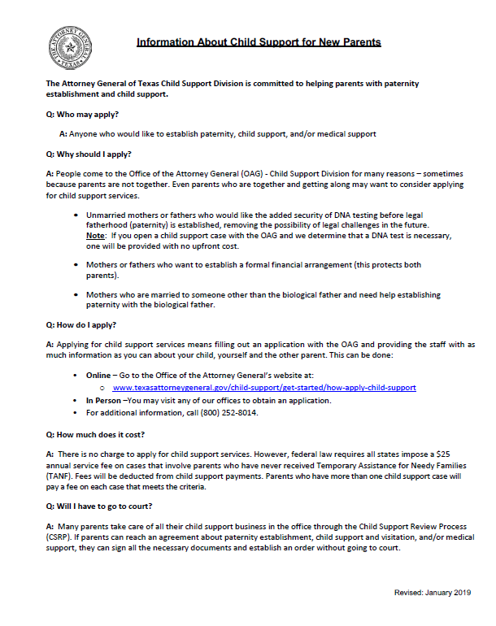
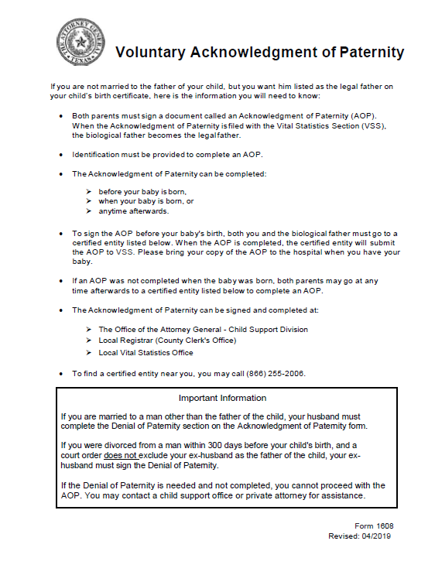
Instructions
Step 6: Complete a Parent Survey
Mother Declines AOP
Provide parents the following documents:
Voluntary Acknowledgment of Paternity handout
Information about Child Support for New Parents
Notes:
Note to Trainer: This page will be updated after the AOP Manual is updated by OAG Graphics.

Slide 56
Instructions
Step-by-Step
Step | Process | Complete?
1 | Determine whether an AOP is appropriate
2 | Provide all required information
3 | Reassess whether an AOP is appropriate
4 | Complete the AOP
5 | Review the completed AOP
6 | Complete a Parent Survey
7 | Submit the AOP to VSS via TxEVER
8 | Provide all required copies to parent(s)
9 | Retain original documents

Slide 57
Instructions
Step 7: Submit the AOP to Vital Statistics Section
Effective December 28, 2018, VSS no longer accepts AOPs via fax machine.
All AOPs will be submitted via TxEVER.
Please follow the steps in the Vital Statistics’ TxEVER Registration Guide for submitting, birth matching and releasing the record in TxEVER.

Slide 58
Instructions
Step-by-Step
Step | Process | Complete?
1 | Determine whether an AOP is appropriate
2 | Provide all required information
3 | Reassess whether an AOP is appropriate
4 | Complete the AOP
5 | Review the completed AOP
6 | Complete a Parent Survey
7 | Submit the AOP to VSS via TxEVER
8 | Provide all required copies to parent(s)
9 | Retain original documents

Slide 59
Instructions
Step 8: Provide all required copies to the parent
As a certified entity, you are required to provide each parent who completed the AOP with his or her own copy of the document.
In order to provide clear evidence that the parties had access to all required information prior to signing the AOP, you will:
Make a double-sided copy of the signed AOP that includes the Benefits, Rights and Responsibilities (English only) on the back.
If the signed AOP is uploaded to TxEVER, then parents should also receive a copy of the “TxEVER AOP” that has VSS’ AOP number. This copy should include the BRR on the back of it.
Notes:
Note to Trainer: This process is no different than the previous process used by entities who used TER to complete an AOP.
Same for individuals who complete a manual AOP, make a copy with the BRR on the back of the signed AOP copy.
Parents should receive a copy of the BRR on the back of the “TxEVER AOP” (document with VSS’ AOP number on it) and a copy of the BRR on the back of the “Manual AOP” (document with parents’ signatures).

Slide 60
Instructions
Step 8: Provide all required copies to the parent
Write or stamp ‘COPY’ on the front side of each copy in the bottom left-hand corner.
Inform each party that a certified copy of the signed AOP may be obtained from the Vital Statistics Section by using the AOP Inquiry Request form VS-134.1.
Daniel John Zuko
Betty Rizzo Zuko
07 15 2019 Rydell County TX
Sandra Maria Olsen
12 06 1996 123 23 1234 58 Grease Lighting Rydell TX 76904
05 11 1995 WITHHELD BY REQUEST
Withheld by request
JLO Jennifer Lopez Ortiz – Birth Registrar
Front page of parent’s copy
Daniel J. Zuko 7-16-19
Sandy Olsen 7-16-19
COPY
Document for training purposes only
3 3 3 3
Notes:
Note to Trainer: Remember TxEVER displays “signatures on file” when the parties sign a paper AOP.
The best practice is for the certified entity to provide all AOP copies:
TxEVER version that says “signature on file” and has VSS’ AOP file number, and
the copy of the wet signature version.

Slide 61
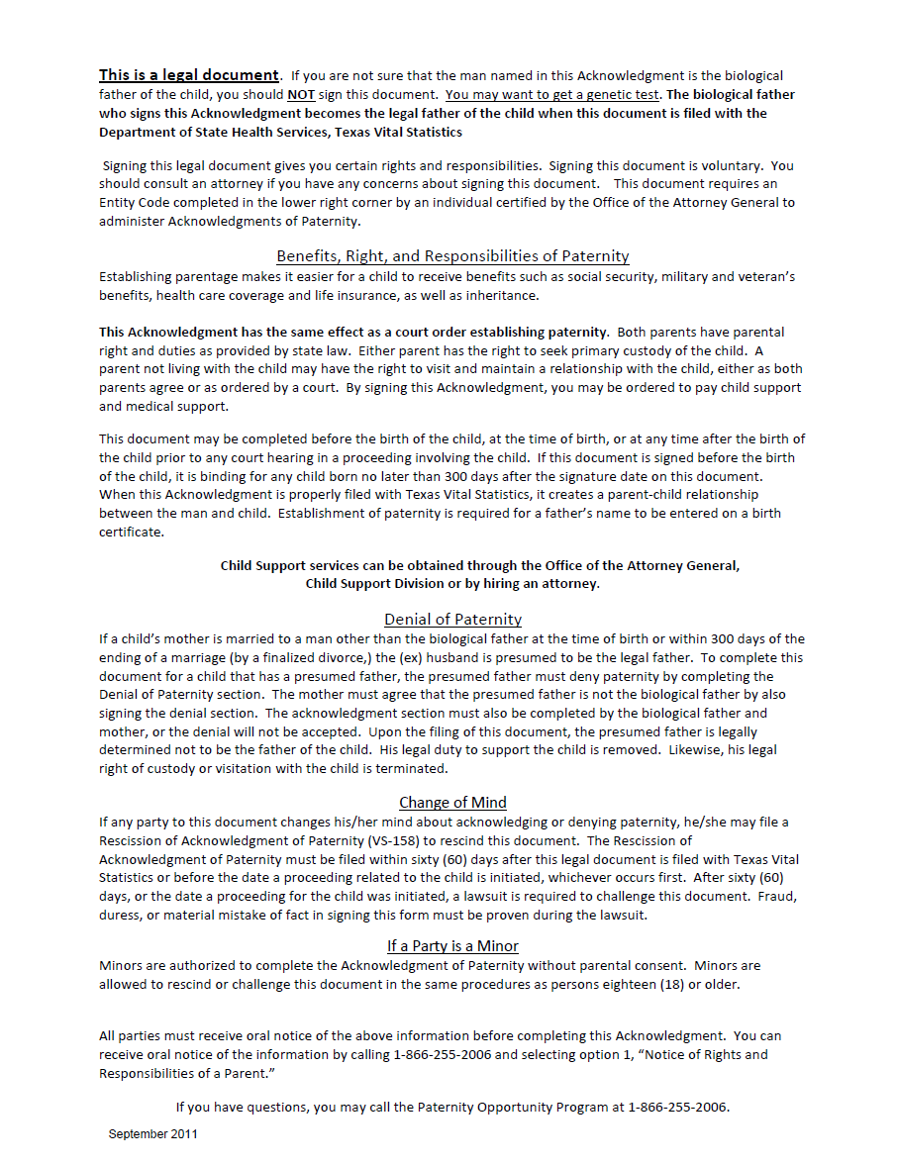
Instructions
Step 8: Provide all required copies to the parent
Back page of Parent’s Copy

Slide 62
Instructions
Step-by-Step
Step | Process | Complete?
1 | Determine whether an AOP is appropriate
2 | Provide all required information
3 | Reassess whether an AOP is appropriate
4 | Complete the AOP
5 | Review the completed AOP
6 | Complete a Parent Survey
7 | Submit the AOP to VSS via TxEVER
8 | Provide all required copies to parent(s)
9 | Retain original documents

Slide 63
Instructions
Step 9: Retain original documents
Completed AOP
Parent Survey, with copy of identification
Retain documents in a centralized, secure location for a minimum of 2 years from the date you completed the AOP in TxEVER.
Notes:
TxEVER will store information on when an AOP record is created, by whom, and whether it is linked to a birth record.
Be sure to follow your organization’s retention schedule. Keep in mind that once the AOP is completed in TxEVER, any printed copy of the AOP is considered transitory.
Keep the AOP with the AOP number from VSS (“TxEVER uploaded AOP”) and the AOP without the AOP number from VSS (“Wet Signature/Manual AOP”).

Slide 64
Special Circumstances

Slide 65
Special Circumstances
DNA Testing
Presumed Father
Common Law
Partial AOPs
Before Birth AOPs
When not to complete an AOP
Rescission
Notes:
The slide simply serves as a “table of contents” for the special circumstances section.

Slide 66
Special Circumstances
DNA Testing
What if one or both parents ask about DNA testing at any point in the process?
Even when parents are sure, they may want DNA testing to erase doubts others may have.
Parents can still use an AOP to establish paternity after they get genetic testing.
Document for training purposes only
Notes:
*Note to Trainer: Certified entities can explain DNA testing and if the parents appear to have doubts, the certified entity can encourage the parties to complete the AOP after DNA testing is completed.

Slide 67
Special Circumstances
DNA Testing
Provide parents with the handout Information about Child Support for New Parents.
Explain to the parents their DNA testing options:
Over-the-counter tests
Private labs
Office of the Attorney General when a child support case is open, and paternity has not been established
Only DNA tests conducted through a lab accredited by the American Association of Blood Banks (AABB) will be considered in court.

Slide 68
Special Circumstances
Presumed Father
An AOP can be used if the presumed father is not the biological father and the biological mother and biological father want to establish paternity for the child.
A presumed father is:
A man married to the mother at the time of the child’s birth.
The ex-husband when a child is born within 300 days of the divorce unless the divorce decree specifically excludes the ex-husband as the father.
The man who lived with the child continuously during the first two years of the child’s life and represented the child as his own.
Notes:
68

Slide 69
Special Circumstances
Presumed Father
Requires signatures from the mother, presumed father and biological father.
The biological father cannot become the legal father unless the presumed father signs the Denial of Paternity.
The presumed father can only terminate his parental rights with an AOP when the biological father is acknowledging paternity.
Note: Biological mother must sign both the establishment and denial sections of the AOP in order for it to be accepted.
Presumed fathers must know the date of birth and full name of the child, mother and biological father.
Wes Hightower
Mac Hightower
10 10 2019
Bull Gilley TX
Sissy Davis Glen
12 06 1996 with held by request WITHHELD BY REQUEST
05 11 1995 with held by request WITHHLED BY REQUEST
.
.
Wes Hightower 10-12-19
Sissy Davis 10-12-19
Bud Davis
Bud Davis 10-12-19
Sissy Davis 10-12-19
05 11 1982 with held by request WITHHELD BY REQUEST
Document for training purposes only
3 3 3 3
Notes:
69

Slide 70
Special Circumstances
Common Law Marriage
Parents who claim common law marriage are not required to complete an AOP for the father’s name to go on the birth certificate, however…
The federal government (military, Social Security) and some states do not recognize common law marriage. Completing an AOP protects the child’s and the parents’ rights.
Encourage couples claiming common law marriage to complete an AOP. Simply mark the “Common Law Married” box in TxEVER on the mother’s data screen.
Note: Both parents must be 18 to claim common law marriage.
Notes:
70

Slide 71
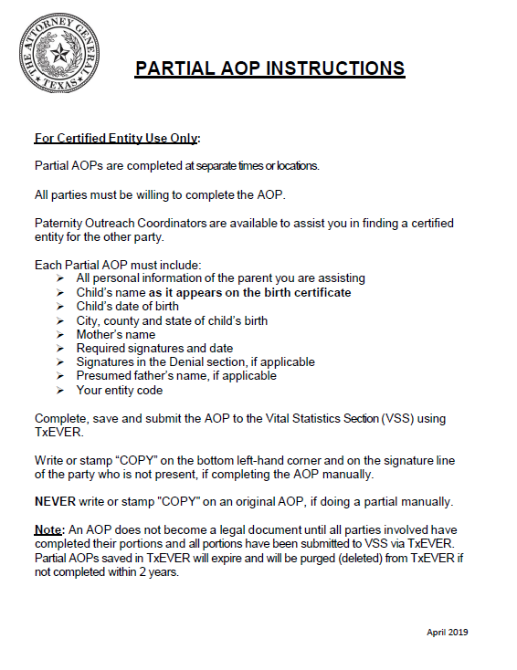
Special Circumstances
Partial AOPs
There may be occasions when parties cannot come to the same certified entity due to:
Active military duty
At another location in Texas
Living in another state or country
Incarcerated
If all parties are willing to complete an AOP, you may assist the parent that is present by completing a partial AOP.
The party seeking to complete their portion of a partial AOP must have the name and date of birth of the parties involved.
Note: All Partial AOPs must be completed in the Pre/Post Birth AOP Registration.
Notes:
Keep in mind that a partial AOP that is saved and submitted to TxEVER is considered “complete” *only after* TxEVER has received signatures from all parties, and after the AOP has been matched and released with a birth record. TxEVER will hold on to the ‘incomplete/partial AOP’ for up to 2 years.
When the absent party comes in to do their partial the Certified Entity will fill out the information in Pre/Post Birth AOP and then search for an AOP record or search for a partial AOP match.
Note to Trainer: As of November 12, 2018, VSS continues to require that presumed fathers know the date of birth and full name of the biological father.

Slide 72
Special Circumstances
Partial AOPs
In this example, the presumed father is the absent party.
The certified entity will complete the party(s) information and presumed father's name in black ink.
Identify the AOP by writing “Partial” above the statement box, if obtaining wet signatures.
Biological father will sign and date the establishment section.
Mother will sign and date the establishment and the denial section.
The certified entity enters the entity code at the bottom.
Adam Chandler
Adam Chandler JR
05 31 2019 Pine Valley Nixon TX
Dixie Maria Martin Cooney
04 06 1998 323 12 9456 14 Mansion Dr Pine Valley TX 76904
02 20 1997 159 15 2463 24 Hope Ave Pigeon Hollow TX 76904
Partial
Adam Chandler 06-01-19
Dixie Martin 6-1-19
Thadius James Martin
Dixie Martin 6-1-19
09 30 1995
Document for training purposes only
3 3 3 3

Slide 73
Special Circumstances
Partial AOPs
In this example, the presumed father completes his denial (partial AOP).
The certified entity will complete the party(s) information and presumed father's name in black ink.
Identify the AOP by writing “Partial” above the statement box, if obtaining wet signatures.
The presumed father will sign the denial section.
The certified entity enters the entity code at the bottom.
Adam Chandler
Adam Chandler JR
05 31 2019 Pine Valley Nixon TX
Dixie Maria Martin Cooney
04 06 1998
02 20 1997
Partial
Thadius James Martin
Thadius J Martin 6-12-19
09 30 1995 888 88 8888 123 Allen Rd Harper Valley, Texas 77060
Document for training purposes only
3 3 3 3

Slide 74
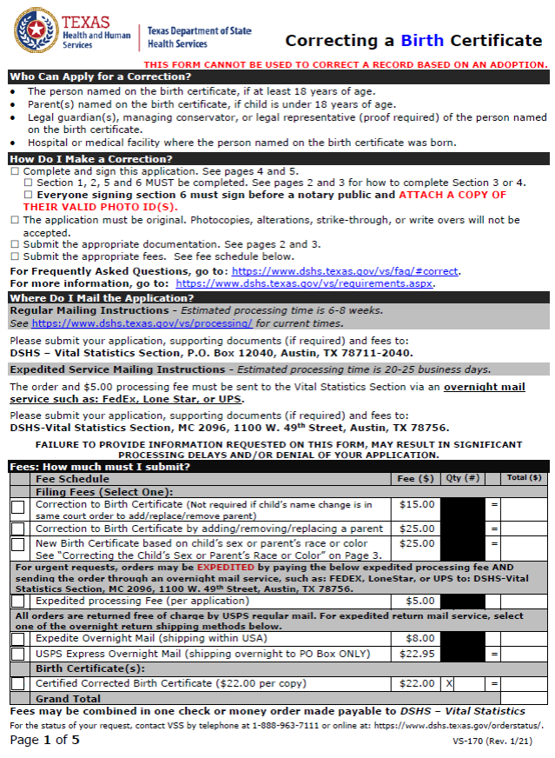
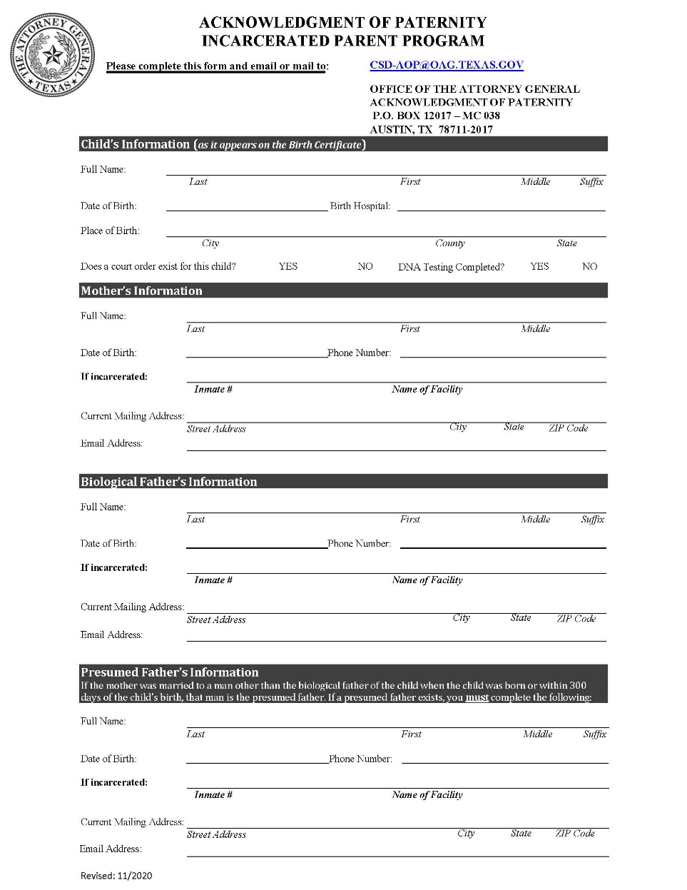
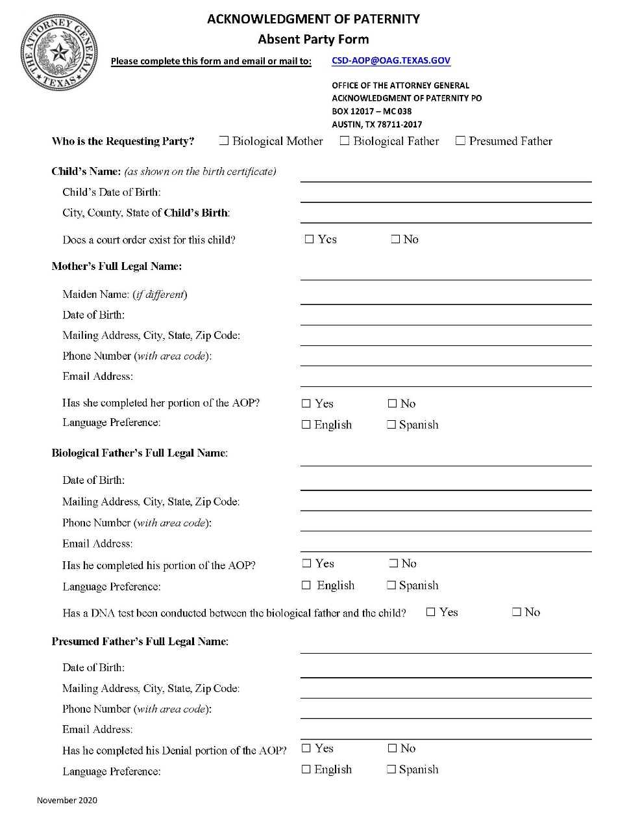
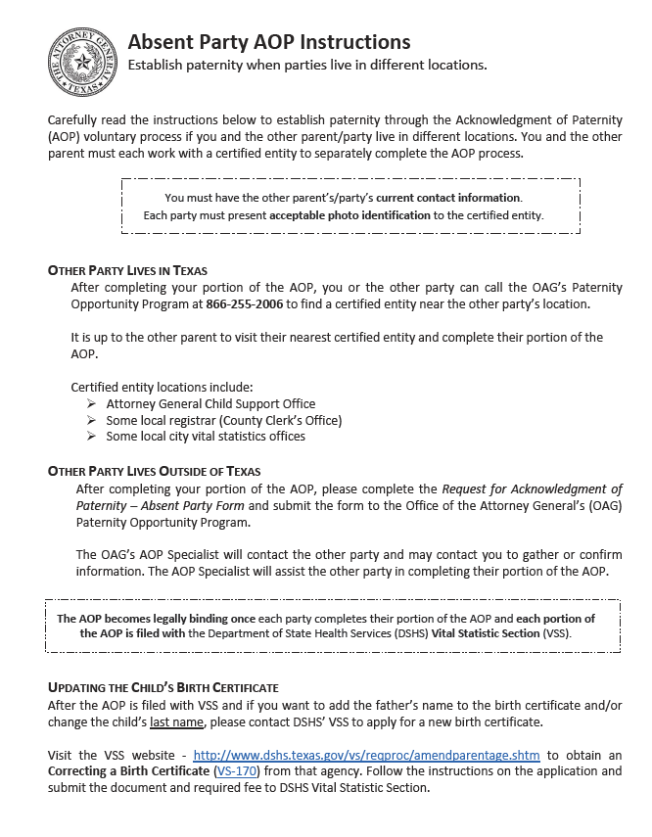
Special Circumstances
Partial AOPs
After submitting the AOP to VSS via TxEVER.
Provide the parties with:
A front and back copy of the Partial AOP
Absent Party Instructions handout
If the Absent Party lives in another state or country provide them with Absent Party Handout
If party is incarcerated provide them with the Incarcerated Parent Form.
VS-170 Correcting a Birth Certificate
Notes:
Note to Trainer: Please emphasize to the trainees that VSS designed TxEVER to retain partial AOPs for up to a two-year period (from date of first entry into TxEVER). After two years have passed, TxEVER will delete the incomplete partials. If parties return after two years to complete the AOP process, they must start from scratch.

Slide 75
Special Circumstances
Partial AOPs
Important Note:
VSS recognizes the AOP as valid when all parties complete their portion of the AOP, and all portions of the AOP are submitted via TxEVER.
Partially completed AOPs will remain in TxEVER up to 2 years.
After that point, if the partial AOPs have not been matched and linked to a birth record, TxEVER will delete the incomplete partials.

Slide 76
Special Circumstances
Before Birth AOP
Pre-birth AOP steps are essentially identical to the post-birth AOPs.
The only difference is that the date of birth will be a date in the future, rather than a date in the past.
Pre-Birth AOPs in TxEVER – parents do not need to provide a first name for their child. All names and DOBs will be updated at the time of birth.
Remember to give parties copies of the completed AOP to take with them to their hospital for delivery. This will help with the matching process.
Jack Sparrow
Projected DOB
Infant Sparrow
07 18 2019
Blue Savvy TX
Angelica Black
Note: If using a manual AOP or obtaining wet signatures be sure to write Projected DOB on the AOP.
01 06 1997 123 23 1234 86 High Sea Blue TX 76904
04 10 1998 432 13 2321 86 High Sea Blue TX 76904
Jack Sparrow 3/2/19
Angelica Black 3/2/19
Document for training purposes only
3 3 3 3

Slide 77
Special Circumstances
Do not complete an AOP when:
Child’s biological parents are legally married to each other.
ID is not available.
You are related to or know one of the parties well. (Consult another entity to complete the AOP.)
Parents want to use it as a form of adoption.
The child was born to a surrogate parent.
The parents are a same-sex couple.
Parents are incapable of understanding an AOP.
There is a child support order for the child.
There is a court order establishing paternity.
An individual is attempting to sign for a parent by a general power of attorney.
Any party is deceased.
The child has a presumed father who is unwilling to sign the denial of paternity within an AOP.
Document for training purposes only
Notes:
This very clearly states that the AOP is not be used with same-sex couples. That means, same-sex married or unmarried couples. The AOP establishes legal fatherhood. It does not establish legal parentage.

Slide 78
Administrative Rescission Guidelines
An AOP may be rescinded by executing and filing a Rescission of Acknowledgment of Paternity form (VSU-158) before the earlier of:
The 60th day after the AOP form or all partial forms were filed with VSU
or
The day a legal proceeding involving the child is initiated before a court.
After this, a court proceeding and a court order are required to challenge an AOP.
Notes:
The rescission process will remain a manually completed process.
Rescission forms will not need to be uploaded in to TxEVER by certified entities.
VSS will mark AOPs that have been rescinded so that when we search for an AOP we will see that the form is no longer valid.

Slide 79
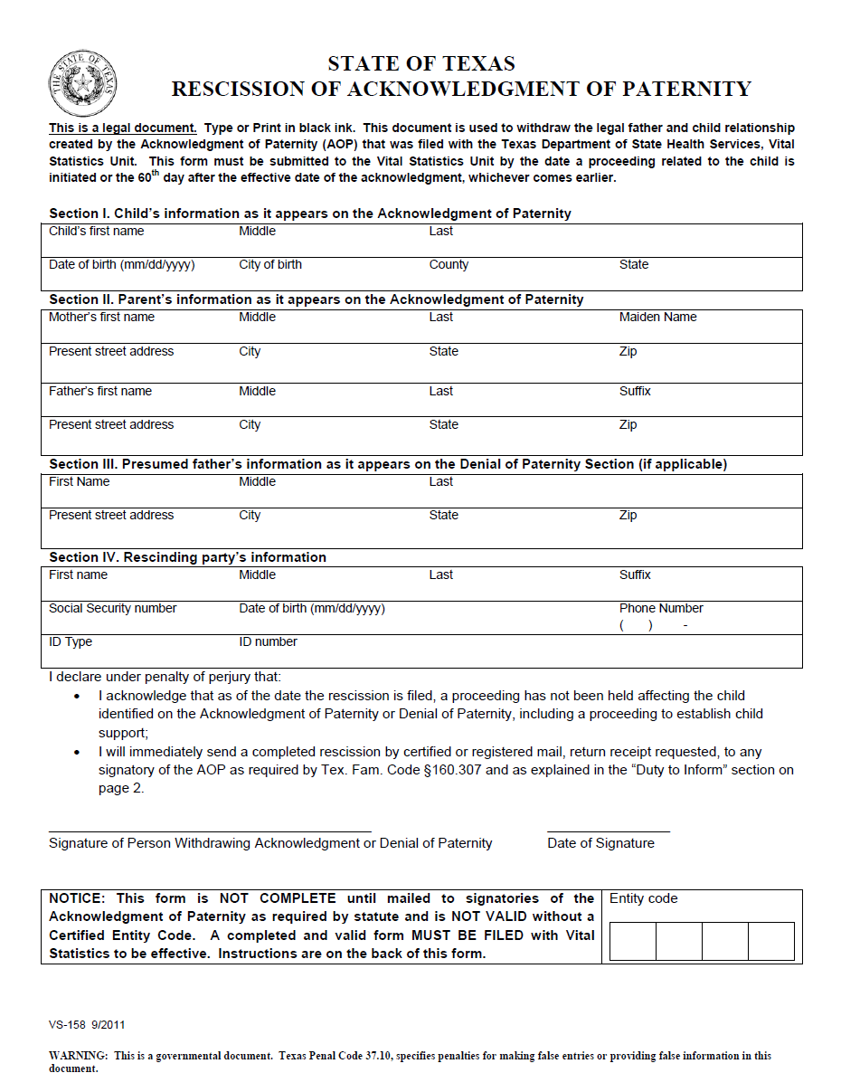
Administrative Rescission Guidelines
Certified Entity Responsibilities
Rescinding party must present ID (see Appropriate Identification listed in your manual).
You cannot give out blank documents to be completed at a later date.
The rescinding party must complete all required fields:
Child’s information as it appears on the completed AOP
Mother’s name and address
Biological father’s name and address
Presumed father’s name and address (if applicable)
Rescinding party’s information
Rescinding party’s signature and date
Document for training purposes only
Notes:
The rescission form continues to be a manual process.
Once the parent mails the forms/documents to VSS, then VSS will complete the rescission via TxEVER upload of the document.

Slide 80
Administrative Rescission Guidelines
Certified Entity Responsibilities
Similar to the AOP process, the rescinding party may withhold his or her:
Social Security number
Address
Phone number
If the rescinding party withholds any of this information, he or she will write “Withheld by Request” in the appropriate filed(s).
Inform the party seeking to withhold information that if VSS has a problem with the form as submitted and cannot reach the party for a timely correction, the form may be rejected.

Slide 81
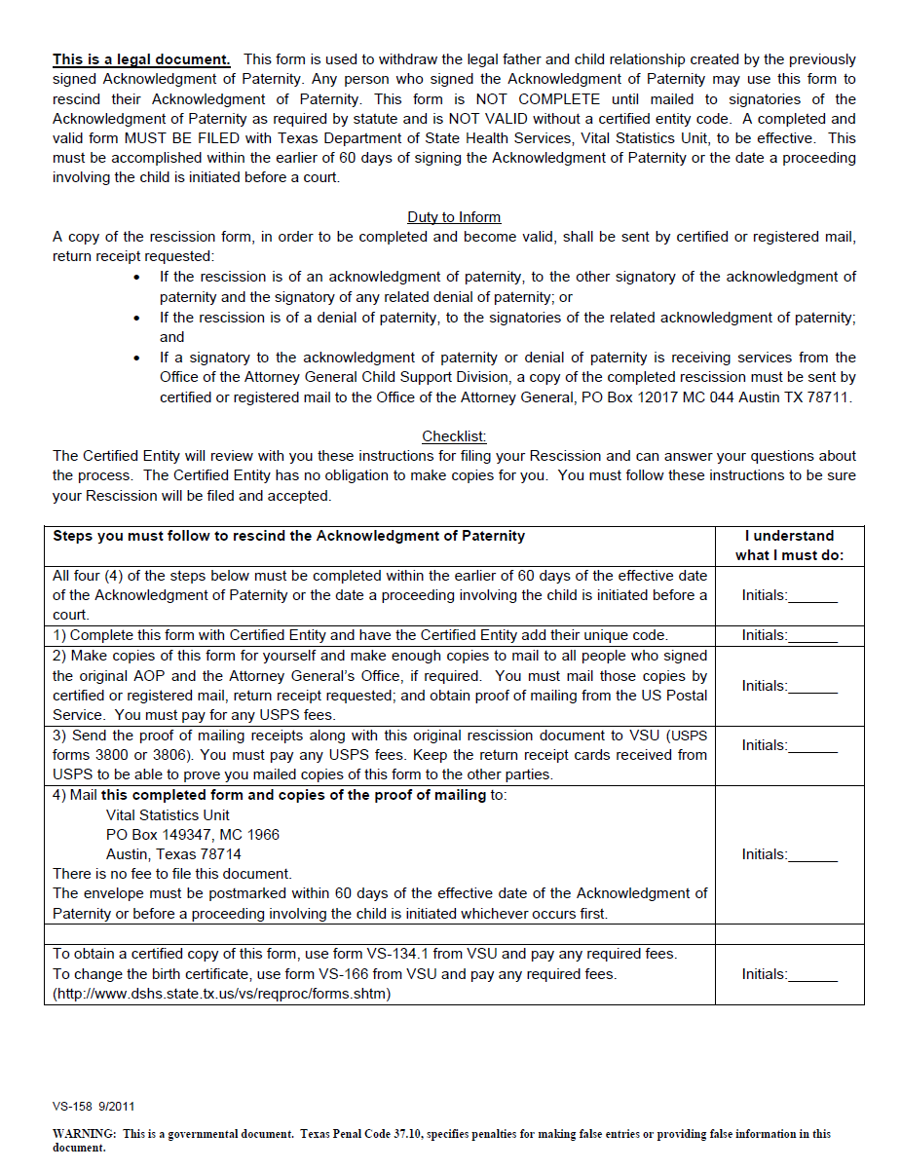
Administrative Rescission Guidelines
Certified Entity Responsibilities
On the front of the form, read the declarations aloud to the rescinding party.
On the back of the form, read aloud the checklist and have the rescinding party initial each section.
Return to the front of the form and have the rescinding party sign and date.
Enter your entity code.
Make copy of the rescission form and the party’s ID.
COPY
Document for training purposes only

Slide 82
Administrative Rescission Guidelines
Certified Entity Responsibilities
Unlike the AOP process, the certified entity will give the original Rescission of AOP to the rescinding party.
The certified entity will retain:
A front and back copy of the rescission form
A copy of the rescinding party’s ID
It is recommended you use the current OAG record retention policy of 2 years for paternity documents.

Slide 83
Administrative Rescission Guidelines
Rescinding Party’s Responsibilities
After the Rescission of Acknowledgment of Paternity has been completed, the rescinding party is responsible for making front and back copies of the Rescission of Acknowledgment of Paternity form.
The rescinding party must mail copies of form by certified or registered mail, return receipt requested, to the following parties:
Mother of child
Father of child
Presumed father (if applicable)
Office of the Attorney General Child Support Division (if a child support case is open for the child associated with the AOP)

Slide 84
Administrative Rescission Guidelines
Rescinding Party’s Responsibilities
After the Rescission of Acknowledgment of Paternity has been completed, the rescinding party must:
Obtain proof of mailing from the U.S. Postal Service.
Pay any fees associated with mailing.
Send copies of the proof of mailing along with the original rescission document to VSS.
Keep the return receipt cards received from U.S. Postal Service to prove copies of the form were mailed to the other parties.
Certified copies of the Rescission form may be obtained from VSS by using the AOP Inquiry Request Form VS 134.1. (pg. 107)
The envelope must be postmarked within 60 days of filing the Acknowledgment of Paternity with VSS or prior to a legal proceeding related to the child is initiated, whichever comes first.

